Slide 1
Software Engineering (Requirement Engineering) _____________________________________________________
Feb 2013

Slide 2
Requirement Engineering
What is Requirement?
  Necessary attribute in a system
  Statement that identifies a capability, characteristic, or quality factor of a system in order for it to have value and utility to a customer / user
  May range from a high-level abstract statement to a detailed mathematical/functional specifications
“… a thing demanded or obligatory…”
“… a need or necessity…”
“… some quality or performance demanded…”
The hardest single part of building a software system is deciding what to build…No other part of the work so cripples the resulting system if done wrong. No other part is more difficult to rectify later -- Brooks ’87

Slide 3
Requirement Engineering: Characteristics
Characteristics of “good requirement”
  Each requirement should be –
  Necessary / Justifiable
  Verifiable
  Attainable
  Unambiguous
  Complete
  Consistent
  Traceable
  Concise
  Implementation- free (Specify “what” not “how”)
Requirement Engineering starts with what the user really needs & not what the provider perceives that the user needs. And it ends when those needs are satisfied
Notes:
All of these characteristics of a good requirement should be self-evident, with the possible exception of "implementation-free." The reason that a requirement should be implementation-free is that requirements specify "what" shall be provided and not "how" -- the how is a design aspect rather than a requirement.

Slide 4
Functional & Non-functional Req.
Functional requirements
  Statements of services the system should provide, how the system should react to particular inputs and how the system should behave in particular situations.
Non-functional requirements
  constraints on the services or functions offered by the system such as timing constraints, constraints on the development process, standards, quality attributes etc.
  Ex : Product req., Org. Req., or External requirements
Domain requirements
  Requirements that come from the application domain of the system and that reflect characteristics of that domain.
Notes:
Non Functional Ex
Product requirement
> The user interface for LIBSYS shall be implemented as simple HTML without frames or Java applets.
Organisational requirement
> The system development process and deliverable documents shall conform to the process and deliverables defined in XYZCo-SP-STAN-95.DOC
External requirement
> The system shall not disclose any personal information about customers apart from their name and reference number to the operators of the system.

Slide 5
Types of Requirements
Business level requirements
  Defines
    Objectives
    Business problems to be solved
    The business opportunity to be addressed
User level requirements
  Defines
    Functionality
    Business rules, Standards, regulations, & guidelines
    Quality Attributes (Reliability, Availability, Security etc)
Product level requirements
  Includes
    Constraints
    External interfaces requirements / constraints
    Data Requirements
Requirements errors account for 70 percent to 85 percent of the rework costs on a software project (Wiegers 2003).

Slide 6
Types of Requirements…..
Business
requirements
Biz
Level
User
Level
User
requirements
Business
Rules
Quality
Attributes
Constraints
Functional
Requirements
Nonfunctional
Requirements
Product
Level
Data
Requirements
Requirements
Specification
External
Interfaces
Requirements
Requirements should specify "what" and not "how"

Slide 7
Requirement Engineering: 4 Ws
What?
  What the software must do to add value for its stakeholders
    Functional & Non-Functional requirements
    Constraints (External interfaces, & other)
Why?
  Benefit of having right requirements
    User satisfaction
    Cost effectiveness
Who?
  Who are stakeholders?
    Those who affect or affected by (Acquirer, Supplier, Others)
When?
  Requirement Engineering - throughout the SDLC
If you don’t get the requirements right, it doesn’t matter how well you do anything else. One can end up doing a perfect job of building the
wrong product. - Karl Wiegers

Slide 8
Requirement Engineering: How?
Inception
Elicitation
Elaboration
Negotiation
Specification
Validation
Requirement Management
Around 40%-50% of the root causes of a project failure are related to Requirement Engineering

Slide 9

Requirement Engineering: Role Play

Slide 10
Requirement Engineering: Inception
Identify Stakeholders (BOs, Users, Others)
Determine CTQs (Critical To Quality)
Define measurable goals
Vision and Scope Document
  Defines background leading to the decision of development
  Describes capabilities, boundaries, & agreed upon “understanding”
Common types of requirements errors include:
Incorrect assumptions (49 percent), Omitted requirements (29 percent), Inconsistent requirements (13 percent), and Ambiguities (5 percent)
Notes:
"vision and scope" document that describes the background leading to the decision to develop a new or modified system and describes capability of the system to be developed. An agreed upon understanding of the capability is critical to a successful project. Consider having iterative scoping meetings with customers and users.

Slide 11
Requirement Engineering: Elicitation
Why Elicitation is difficult?
  Problems of Scope
    Undefined boundaries
    Unnecessary details (technical)
  Problems of understanding
    Customer not sure
    Poor understanding of domain / environment
    Omission of “obvious” information
  Problem of Volatility
Notes:
Why Elicitation is Difficult ?
Problems of scope
-defined boundary
Customers/users specify unnecessary technical detail
Problems of understanding
Customers/users not completely sure of what is needed
Poor understanding of capabilities and limitations of computing environment
Lack of understanding of problem domain
Omission of “obvious” information
Specify requirements that conflict with other stakeholders
Problems of volatility

Slide 12
Requirement Engineering: Elicitation
Define scope and boundaries
Distinguish “stated” & “real” requirements
  “Want” v/s “Need”
Prioritizes requirements
Determine constraints
Determine & Agreed upon
  Statement of need and feasibility
  List of stakeholders (Business owners, users, other)
  System’s technical environment
  List of requirements and constraints
  Usage scenarios
  Prototype, if any
Rework is estimated at 45 percent of project costs, industry-wide
Notes:
Why Elicitation is Difficult ?
Problems of scope
-defined boundary
Customers/users specify unnecessary technical detail
Problems of understanding
Customers/users not completely sure of what is needed
Poor understanding of capabilities and limitations of computing environment
Lack of understanding of problem domain
Omission of “obvious” information
Specify requirements that conflict with other stakeholders
Problems of volatility

Slide 13
Requirement Engineering: Elaboration
Translate requirement into technical design
Document
  Industry standards, Rules, Processes
  Other / external factors impact
Analysis Modeling
  Scenario-based elements
  Class-based elements
  Behavioral elements
  Flow-oriented elements
  Analysis patterns
It is critical that all top level requirements are well iterated between all stakeholders ( Customer (BOs), Users, and developers)

Slide 14
Requirement Engineering: Negotiation
Discuss & Resolve conflicts in requirements
Categorize “Must to have” and “Nice to have”
Develop plan that meets needs and constraints as well
Standish Group (1994) surveyed over 350 companies about 8,000 software projects.
Results: 31% projects were cancelled before they were completed

Slide 15
Requirement Engineering: Specification
Prepare detailed Business Requirement Document (BRD)
  It could be single or multiple document
Agreement with the BOs, Users on the requirement
Baseline the requirements

Slide 16
Requirement Engineering: Validation
Review / Validate requirements to ensure
  Complete
  Consistency
  Modifiable
  Ambiguity
  Concise
  Finite
  Measurable
  Feasible
  Testability
Iterate the process incase of defects, gaps
If one finds a requirements defect during the requirements phase and it costs one unit to fix (for example, three person days, $500), the cost of fixing that same defect will typically increase as it is found later and later in the life cycle. (Can cost more than 100 times more to fix a requirements defect if it is not found until after the software is released

Slide 17
Requirement Engineering: Validation…
Complete & Consistent
  Internal conflicts shall not exist between requirements
  The requirements also shall not conflict with higher-level requirements
  Same terminology should be used consistently within the document
    A word has the same meaning every time it is used.
    Two different words should not be used to mean the same thing
Modifiable
  document is organized and written in a manner that will facilitate making future change
    No redundant: Each requirement is stated in only one place.
    Changeable: Each requirement can be changed without excessive impact on other requirements
Ambiguity
  Each requirement statement should have only one interpretation, and each requirement should be specified in a coherent, easy-to-understand manner
  “ly” search

Slide 18
Requirement Engineering: Validation…
Concise
  Each requirement should be stated in short, specific, action-oriented language
Finite
  The requirement should not be stated in an open-ended manner
  Avoid “all” “every” “throughout” words in statement
Measurable
  Specific, measurable limits or values should be stated for each requirement as appropriate
Feasible

Slide 19
Requirement Engineering: Validation…
Testable
  There exists a reasonably cost-effective way to determine that the software satisfies the requirement
Traceable
  Each requirement should be traceable back to its source
Requirements are the single thread that goes through a project from conception through build, test and implementation

Slide 20
Requirement Engineering: Why it Fails?
Incomplete requirements
Lack of Business Owner / user involvement
Unrealistic expectations
Changing requirements and specifications
Lack of planning
Understandability
  Requirements are expressed in the language of the application domain which is often not understood by software engineers
Implicitness
  Domain specialists understand the area so well that they do not think of making the domain requirements explicit

Slide 21
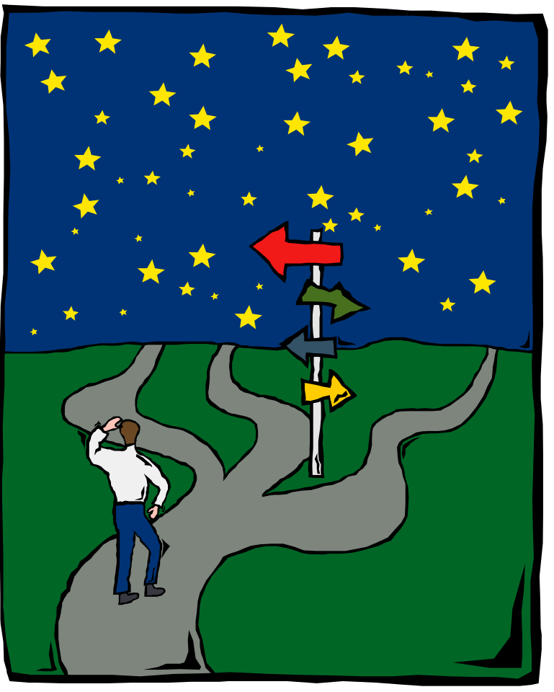
Requirement Engineering: Role Play

Slide 22
Role Play
Design a “form” for capturing following information
  Name
  Birth date
  Address
  Phone No
  Sex
  Marital status
  Occupation
  Note: Fields from 1 to 4 are descriptive entries.
  Fields No 5, 6, and 7 should have options to select

Slide 23
Requirement Engineering: Best Practices
Write & iterate Project Vision & Scope doc.
Initiate a project glossary and a list of acronyms
Evolve the real requirements via a "joint" (BO / user and developer) effort.
Focus on product benefits not features.
Document the rationale for each requirement (why it is needed)
Involve BO/user throughout the process
Perform Verification & Validation

Slide 24
Requirement Engineering: Best Practices...
Establish a mechanism to control changes
Prioritize the real requirements
Ensure same interpretation of same word
Use structured language
Reviews and inspections of all work products
Use automated requirements tool
Provide SMEs (Subject Matter Expert)
Share Information, use best practices
Establish continuous improvement ethic & quality culture

Slide 25
Requirement Engineering: Techniques
Interviews
Document & Process Analysis
Brainstorming
Workshops
Prototyping
Use cases
Storyboards
Interface Analysis
Modeling

Slide 26
Guideline for writing requirements
Invent a standard format and use it for all requirements
Use language in a consistent way
  Ex. Use “shall” for mandatory requirements, “should” for desirable requirements.
Use text highlighting to identify key parts of the requirement.
Avoid the use of computer jargon

Slide 27
Q & A
Any Question?

